Slide 1
Sleep Health and Lifestyle Analysis
Data Scientist: Soizic Bourgeois
© 2024 Udacity.

Slide 2
Agenda
Results of sleep health and lifestyle analysis
Dataset Introduction
Data Description
Typical Amount of Physical Activity
Number of Daily Steps
Distribution of Heart Rates

Slide 3
Dataset Introduction
The Sleep Health and Lifestyle Dataset comprises 400 rows and 13 columns, covering a wide range of variables related to sleep and daily habits.
It includes details such as gender, age, occupation, sleep duration, quality of sleep, physical activity level, stress levels, BMI category, blood pressure, heart rate, daily steps, and the presence or absence of sleep disorders

Slide 4
Data Description
Sleep duration is an example of a continuous variable in the dataset.
Daily Steps is an example of an integer variable in the dataset.
BMI category is an example of an ordinal categorical variable in the dataset.
Occupation is an example of a nominal categorical variable in the dataset.

Slide 5
Typical Amount (Minutes) of Physical Activity
Measures of center:
Mean: 59.2
Median: 60
Mode: 60
The mean, median and mode are almost identical, suggesting a close to normal distribution, slightly left skewed (mean < median)

Slide 6
Analysis of Daily Steps Taken
Standard deviation: 1617.1
Maximum: 10000
Minimum: 3000
Range: 7000
Measures of spread:
Q1: 5600
Median: 7000
Q3: 8000
Measures of center:
Mean: 6816.8
Median: 7000
Mode: 8000
With the mean < median < mode, we can conclude the distribution is left skewed

Slide 7
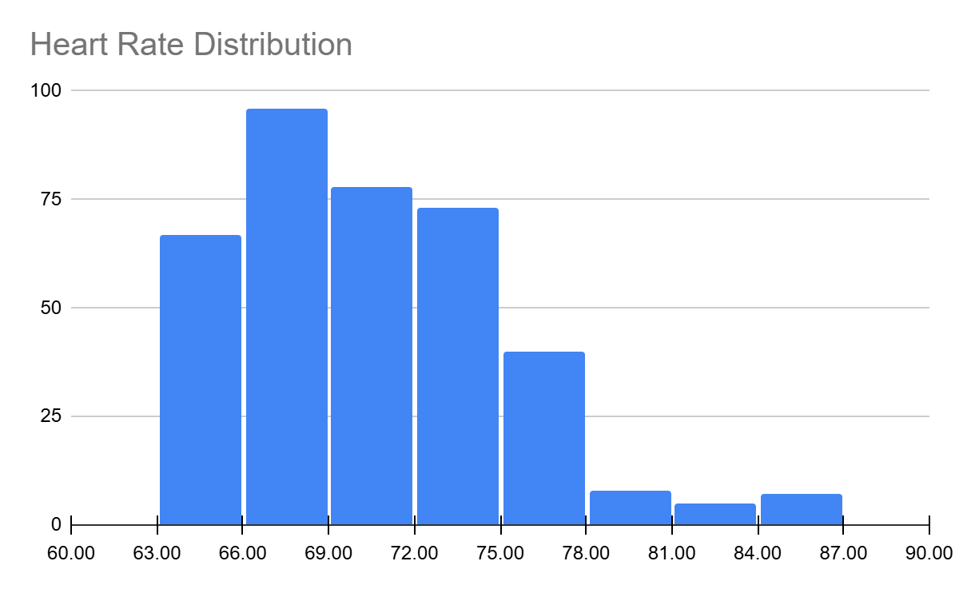
Distribution of Heart Rates
The heart rate distribution is right skewed .
We do not see any outliers

